Slide 1
Sleep Health and Lifestyle Analysis
Data Scientist: Kinan Turman
© 2024 Udacity.

Slide 2
Agenda
Results of sleep health and lifestyle analysis
Data Description
Typical Amount of Physical Activity
Number of Daily Steps
Distribution of Heart Rates

Slide 3
Data Description
Rows: 374
Columns: 13 - Person ID, Gender, Age, Occupation, Sleep Duration, Quality of Sleep, Physical Activity Level, Stress Level, BMI Category, Blood Pressure, Heart Rate, Daily Steps, Sleep Disorder

Slide 4
Data Description
Continuous Variables:
Sleep Duration
Integer Variables:
Person ID, Age, Physical Activity Level, Heart Rate, Daily Steps
Ordinal Categorical Variables:
Quality of Sleep, Stress Level, BMI Category
Nominal Categorical Variables:
Gender, Occupation, Sleep Disorder, Blood Pressure

Slide 5
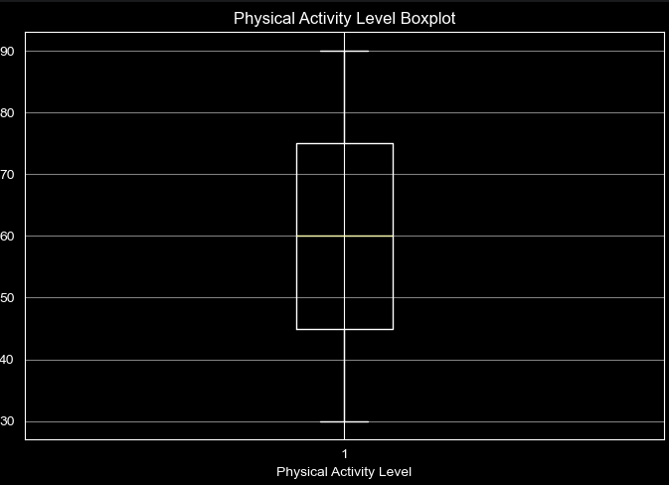
Typical Amount (Minutes) of Physical Activity
Mean: 59.17
Median: 60.0
Mode: 60
What do the relationships between these values suggest about the skewness of the distribution associated with physical activity?
The mean, median and mode can be considered as equal, at ~60. This suggests that the data has a normal distribution.

Slide 6
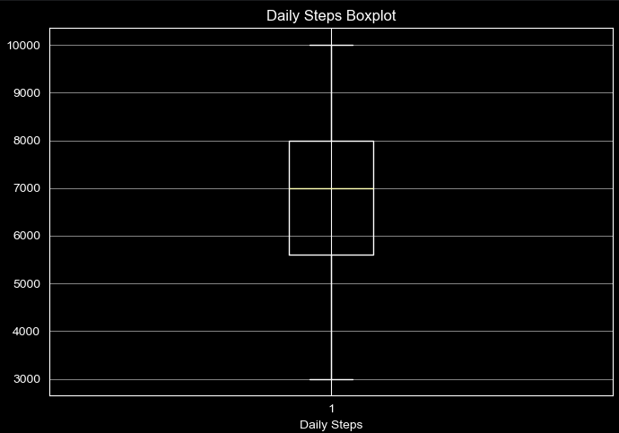
Analysis of Daily Steps Taken
Variance: 2,617,651.14
Standard Deviation: 1,617.92
Maximum: 10,000
Minimum: 3,000
Range: 7,000
Q1: 5,600
Q3: 8,000
IQR: 2,400
Skew: 0.18

Slide 7
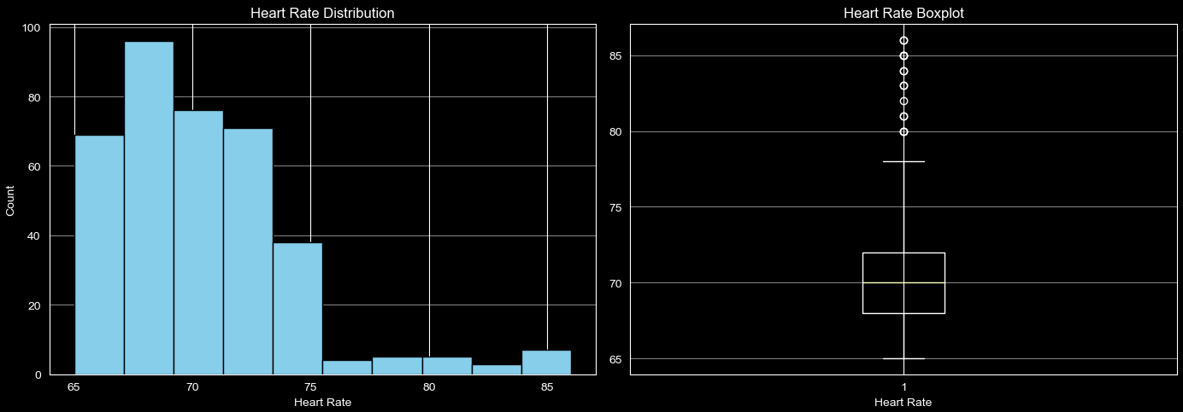
Distribution of Heart Rates
What is the shape of the distribution? Are there any outliers?
Shape is right-skewed. There are several outliers.

